Slide 1
20190130
THz EPR paper research
Non External Magnetic Field EPR research
Lee Jong Geon

Slide 2
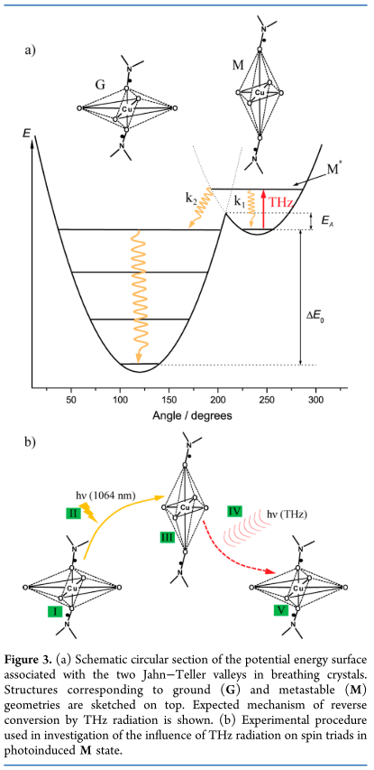
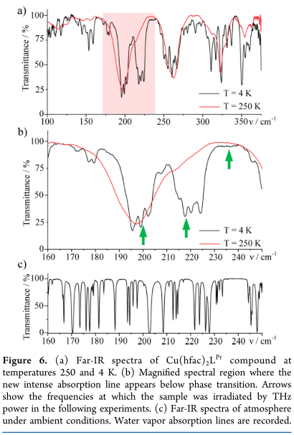
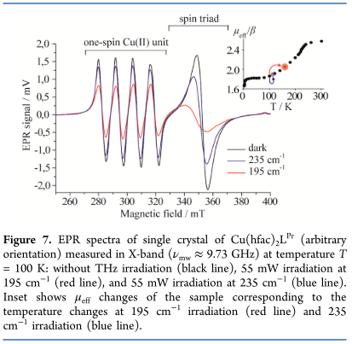
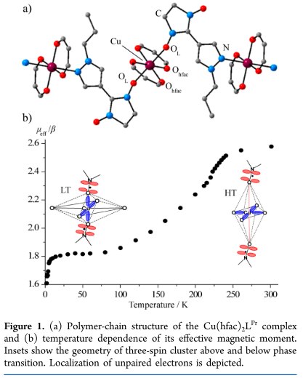
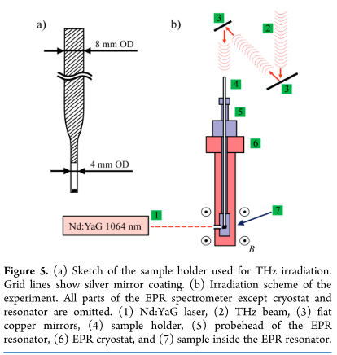
2013-J. Phys. Chem. A-177-Influence of Intense THz Radiation on Spin State of Photoswitchable Compound Cu(hfac)₂L^{Pr} (Sergey L. Veber, Matvey V. Fedin, Ksenia Yu. Maryunina, Kirill N. Boldyrev, Mikhail A. Sheglov, Vitaly V. Kubarev, Oleg A. Shevchenko, Nikolay A. Vinokurov, Gennady N. Kulipanov, Renad Z. Sagdeev, Victor I. Ovcharenko, Elena G. Bagryanskaya)
Cu(hfac)₂L^{Pr}
Mixture of 50 mg of high-density polyethylene (HDPE) powder with a 5 mg of Cu(hfac)₂L^{Pr} powder -> pellet
Far-IR spectra: Bruker IFS 125 HR FT-IP spectrometer with helium cryostat
EPR: Nd:YaG laser (1064nm) and FEL (35-80 μm)

Slide 3
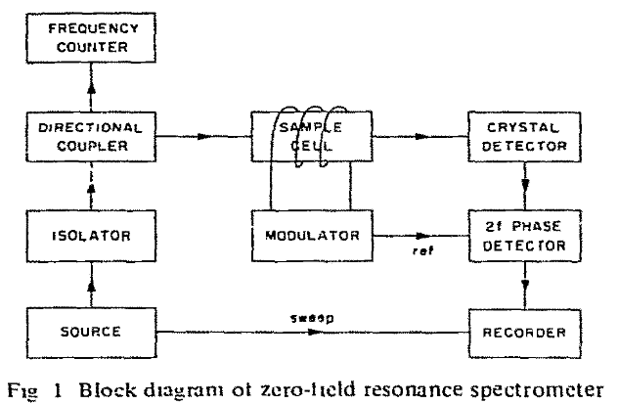
Zero Field Resonance (ZFR)
Magnetic inequivalence of otherwise-identical spins -> the inhomogeneous line broadening -> EPR spectra accuracy limited ⁽¹⁾ => “High field” or “zero field”
In the zero-field spectrometer, the earth’s magnetic field at the sample was canceled to within 10 mG ⁽²⁾
2018-Nature Comm.-9,1-Nanoscale zero-field electron spin resonance spectroscopy⁻ (Fei Kong, Pengju Zhao, Xiangyu Ye, Zhecheng Wang, Zhuoyang Qin, Pei Yu, Jihu Su, Fazhan Shi, Jiangfeng Du)
1970-J. Chem. Phys.-53,5-Magnetic Resonance Spectroscopy of Tirplet-State Organic Molecules in Zero External Magnetic Field (Cylde A. Hutchison, John V. Nicholas, Gary W. Scott)
(Figure) 1981-Chemical Physics Letters-79,2-Improved Spin Hamiltonian Parameters for Mn²⁺ Determined by EPR at Zero Magnetic Field (Richard Bramley, Steven J. Strach)

Slide 4
Zero Field Resonance (ZFR)
When is Zero-Field Splitting (ZFS) present? -> depends on multiple unpaired electrons spin state
Spin |  | example | complex of
Spin Triplet, S=1 | No ZFS | [Ni(NH₃)₆]I₂ | Ni(II) (3d⁸, S=1)
 | with ZFS, No EMF
 | with ZFS, with EMF |  | V(III) (3d²); Ni(II) (3d⁸)
Spin Quartet, S=3/2 | No ZFS, with EMF | [Cr(NH₃)₆]I₃ | Cr(III)
 | with ZFS, No EMF
 | with ZFS, with EMF
Spin Quintet, S=2 | No ZFS
 | with ZFS, No EMF | * (M^{I})₂[M^{II}(H₂O)₆](SO₄)₂; M^{I}=Rb⁺, Cs⁺; M^{II}=Cr²⁺ * M^{I}[M^{III}(H₂O)₆](SO₄)₂·6H₂O; M^{I}=Cs⁺;M^{III}=Mn³⁺ *Cs[Fe(H₂O)₆]PO₄ | Mn(III) (3d⁴); Cr(II) (3d⁴) Fe(II) (3d⁶)
 | with ZFS, with EMF
Spin Sextet, S=5/2 | No ZFS |  | [Mn(Nh₃)₆]²⁺
 | with ZFS, No EMF | octahedral oxide, fluoride alttices, tetrahedral chalcogenide alttiecs | Cr(I) (3d⁵); Mn(II) (3d⁵); Fe(III) (3d⁵)
 | with ZFS, with EMF | (NH₄)[Fe(EDTA)] (EDTA=ethylenediamine tetraacetatetetraanion) | low-symmetry Mn(II), Fe(III)
Spin Septet, S=3 | with ZFS, No EMF | MnH, MnF two ferromagnetically coupled S=3/2 Cr(III) ions | Mn(I) (3d⁵4s¹)
 | with ZFS, with EMF |  | dinuclear Cr(III)
Spin Octet, S=7/2 | No ZFS, with EMF |  | Gd(III) (4f⁷); Eu(III) (4f⁷); Tb(IV) (4f⁷)
 | with ZFS, No EMF
 | with ZFS, with EMF |  | Gd(III) (coupled system)
2018-Wiley-EPR SPECTROSCOPY: Fundamentals and Methods (Daniella Goldfarb, Stefan Stoll)

Slide 5
Non External Magnetic Field EPR research
Experiment관련 paper research
EPR Study

